Slide 1
Hello Europe!!!
CHILDREN GREET THEIR CLASSMATES
CHILDREN INTRODUCE THEMSELVES

Slide 2
WHO WE ARE. We are VERY HAPPY PUPILS because YOU are our European FRIENDS. We are delighted to be working on this eTwinning project called HELLO EUROPE! Our primary school is in Ľutina, a cute Slovak village.

Slide 3
HELLO EUROPE!!!

Slide 4
We are 3rdA class.

Slide 5
We are from SLOVAKIA. Our country is in the heart of Europe.

Slide 6
Ľutina is right here.

Slide 7
Let me greet you and introduce myself.
Hello! My name is KLAUDIA.

Slide 8
Let me greet you and introduce myself.
Hello! My name is ADRIANA.

Slide 9
Let me greet you and introduce myself.
Hello! My name is SIMONA.

Slide 10
Let me greet you and introduce myself.
Hello! My name is VIKTORIA.

Slide 11
Let me greet you and introduce myself.
Hello! My name is MARTIN.

Slide 12
Let me greet you and introduce myself.
Hello! My name is ERIK.

Slide 13
Let me greet you and introduce myself.
Hello! My name is LADISLAV.

Slide 14
Let me greet you and introduce myself.
Hello! My name is MAREK.

Slide 15
Let me greet you and introduce myself.
Hello! My name is LIANA.

Slide 16
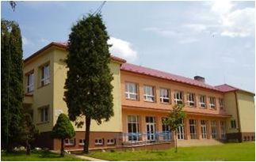
Greetings from Ľutina. Goodbye.

